Slide 1
WELCOME TO OUR CLASS - 8A1
Unit 4: Our customs and tradition
Lesson 5: Skills 1

Slide 2
CHECK THE OLD LESSON
Follow the table manners, should we talk when chewing food?
2. Should we place our chopsticks on the rice bowl when we finish eating?
3. If you are the host/hostess, should you serve the food for the guests during the meal?

Slide 3
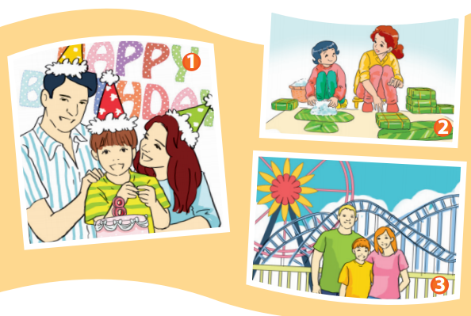
I. READING
Task 1: Look at the pictures and answer the questions.
1. What are the people doing in each picture?
→
2. Does your family ever do the same things?
→

Slide 4
1. What are the people doing in each picture?
Picture 1: A family is celebrating a birthday.
Picture 2: People are making chung cakes.
Picture 2: A family is at an amusement park.
2. Does your family ever do the same things?
Yes, we do
No, we don’t

Slide 5
Task 2: Vocabulary
- Sense of belonging (n)
: cảm giác thân thuộc.
c
- grilled chicken
: thịt gà nướng
- wedding anniversary
: kỉ niệm ngày cưới

Slide 6
Task 3: Read Mi’s presentation on customs and traditions. Is she writing about her family or her society?
In my opinion, customs and traditions are very important. Like other families, we have our own customs and traditions.
A. Firstly, there’s a tradition in our family of having lunch together on the second day of Tet. Everyone has to be there before 11 a.m. We have followed this tradition for three generations.
B. Secondly, we have the custom of spending Sunday together. We usually go to the cinema or go for a picnic. We don’t have to do it, but it makes us closer as a family.
C. Thirdly, we celebrate our grandparents’ wedding anniversary on the first Sunday of October because they don’t remember the exact date. The custom is that we have to cook a new dish each year. Last year, my mum cooked lasagne, an Italian dish. This year, we prepared five-coloured sticky rice served with grilled chicken. We all enjoy these customs and traditions because they provide our family with a sense of belonging.

Slide 7
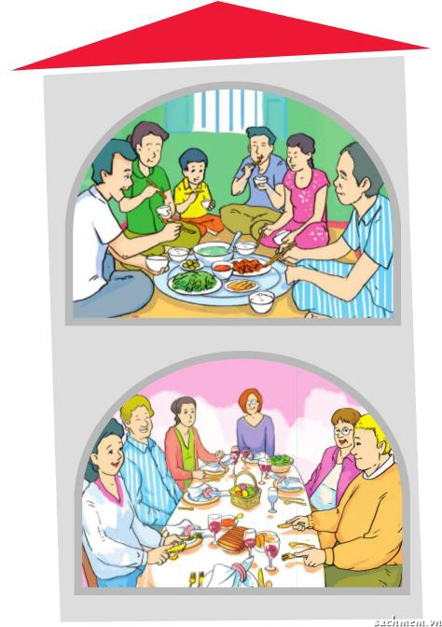
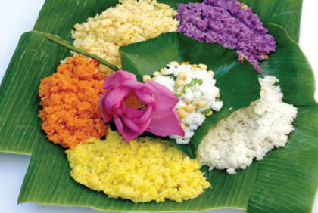
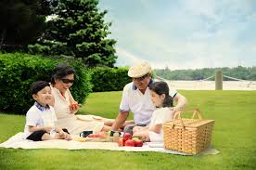
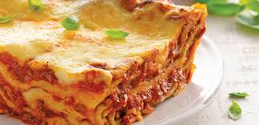
Is she writing about her family or her society?
Answer: She is writing about her family.

Slide 8
Task 4: Now decide in which paragraph each detail below is mentioned. Write A, B, or C in the blank.
 | A | B | C
1. the name of an Italian dish
2. the time family members have to gather for lunch
3. the date of the wedding anniversary
4. an outdoor activity
5. the length of time a tradition has existed
6. the reason for spending time together
L22
✔
✔
L5
✔
L16,17
L11,12
✔
✔
L7,8
✔
L12,13

Slide 9
Task 5: Read the text again and answer the questions.
What are the three customs or traditions Mi mentions?
→
What does Mi’s family usually do on Sundays?
→
What is the date of her grandparents’ wedding anniversary?
→
What did they make for the grandparents’ wedding anniversary this year?
→
Why do they love family customs and traditions?
→
They are: having lunch together on the second day of Tet, spending Sunday together, and celebrating her grandparents’ wedding anniversary on the first Sunday of October.
They usually go to the cinema or go for a picnic together.
They don’t remember.
They made five-coloured sticky rice served with grilled chicken.
Because they provide a sense of belonging.

Slide 10
II. speaking
Task 6: Work in pairs and discuss the questions.
1. What are the three customs and traditions you like most in your family? Describe them in detail.
2. How do you feel when you take part in these customs and traditions?
3. Why is it important to continue family customs and traditions?

Slide 11
Suggestions
1. What are the three customs and traditions you like most in your family? Describe them in detail.
→ We have tradition of celebrating family member’s birthday. We also have custom of having dinner together. At Tet, we have tradition of making foods: sticky rice, spring roll, chung cake.
2. How do you feel when you take part in these customs and traditions?
→ They are so meaningful and I feel happy to be a part of our traditions and customs.
3. Why is it important to continue family customs and traditions?
→ They make family member closer and love each other more.

Slide 12
6. Interview another pair to get their answers to the questions in 5. Note down their answers in the table below. Then present what you have found out to the class.
Names of interviewees | Q1: the three customs and traditions…? | Q2: How do you feel… ? | Q3: Why is it important to continue… ?
1. Nam | Having dinner with family, going picnic at the end of month, going travelling in summer | So wonderful | People understand and love each other.
2. ____________________ | making foods: sticky rice, spring roll, Chung cake... | so meaningful, feel happy to be a part of our traditions and customs | They make family member closer and love each other more.
3. ____________________
...

Slide 13
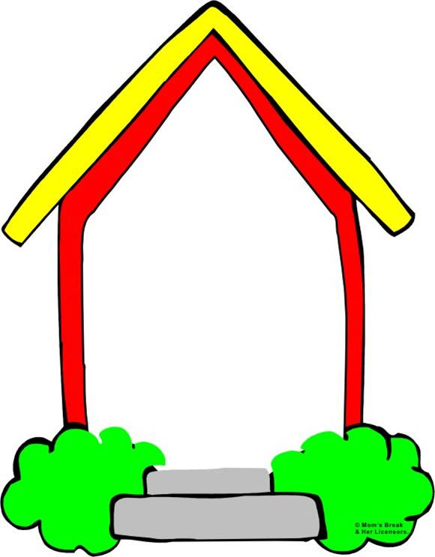
Homework
1. Write vocabulary.
2. Prepare Skills 2.

